Slide 1
ChronicCoder Anime Recommender
User Research Report
Joey Wong
Your fellow resident researcher and designer

Slide 2
Overview
Research Goals
Identify user groups, needs and wants
Evaluate usability of the current website
Evaluate functions and features of the current algorithm
Obtain feedback on future ideas/suggestions

Slide 3
Recruitment
Goals
Equal representation across all experience levels and gender
Emphasis on amateur experience due to potential sub-groups

Slide 4
Recruitment
User requirements
Categorized based on (in order of priority):
Number of anime watched (lifetime)
How often they watch anime
Knowledge of tastes and preferences
Knowledge on seasonal anime
The higher the experience level, the higher they score in these categories.

Slide 5
Recruitment
Participant Distribution
5 male, 5 female (includes 1 pilot)
Average age: 23.8 years old
All Asian
South East Asian
South Asian
Mixed asian
Experience Levels | Participants
Novice (N) | 2
Novice-Amateur (NA) | 1
Amateur (A) | 3
Amateur-Experienced (AE) | 1
Experienced (E) | 2
TOTAL | 9 (+1 pilot)

Slide 6
Personas
Our archetypes
Meet our users!

Slide 7
Personas
Goal
Categorize our users into varying proportions
Base design decisions off different groups
Guide future research goals
Target specific needs and pain points

Slide 8
Personas
User descriptions
Experience Level | # anime watched | Watching frequency | Knowledge of tastes and preferences | Knowledge on seasonal anime
Novice (N) | Low (1-20) | Low to high | Low | Low
Novice-Amateur (NA) | Low-Med (21-30) | Low to high | Low-Medium | Low-medium
Amateur (A) | Medium (20-60) | Medium-High | Medium-High | Medium
Amateur-Experienced (AE) | Medium (40-60) | Medium-High | Medium-High | Medium-high
Experienced (E) | High (60+) | High | High | High

Slide 9

Personas
The Follower
Has outgrown anime over the past few years
Watches anime only if it’s popular among their friend group or social circles
Doesn’t actively seek out anime to watch
# anime watched | Watching frequency | Knowledge of tastes and preferences | Knowledge on seasonal anime
Low (1-20) | Low | Low | Low

Slide 10

Personas
The Newbie
Recently got into anime (first-timer or returning)
Started because of a recently-popularized anime
Actively seeking out anime similar through social circles and social media
# anime watched | Watching frequency | Knowledge of tastes and preferences | Knowledge on seasonal anime
Low (1-20) | High | Low | Low

Slide 11

Personas
The Selective Watcher
Been watching anime for some time
Finds it tough to seek out new anime because of a very specific palette
Has given up on searching for recommendations
# anime watched | Watching frequency | Knowledge of tastes and preferences | Knowledge on seasonal anime
Medium (20-60) | Medium | High | Medium

Slide 12

Personas
The Phase Shifter
Watches anime in phases (interests comes and goes)
Will have an intense interest in anime when the phase comes
Utilizes all forms of sources to find new anime
# anime watched | Watching frequency | Knowledge of tastes and preferences | Knowledge on seasonal anime
Med-High (20-60+) | Sporadic | High | Medium

Slide 13

Personas
The Closet Weeb
Similar to The Weeb, but watches sporadically due to limited free time
Actively seeks out anime via social media and circles
# anime watched | Watching frequency | Knowledge of tastes and preferences | Knowledge on seasonal anime
High (60+) | High (not as much as The Weeb) | High | High

Slide 14

Personas
The Weeb
Long time anime watcher, embraces manga, Japanese culture enthusiast
Follows multiple anime at once, watches frequently
Knowledgeable on all genres of anime, flexible in genre
Uses the largest variety of sources for recommendations
# anime watched | Watching frequency | Knowledge of tastes and preferences | Knowledge on seasonal anime
High (60+) | High | High | Medium

Slide 15
Findings
The funnest part.
Let’s see how we did...

Slide 16
Research
Method: Remote Interview + Usability Test
Interview (15-20 mins)
Discover user’s anime viewing habits
Learn their experiences in finding new anime
Identify anime preferences
Semi-guided Usability Test (15-20 minutes)
Evaluate usability of existing design
Identify design changes and issues
Guide future iterations
Wrap-up (5-10 minutes)
Final comments

Slide 17
Findings: Interview
What appeals to them in an anime?
Majority prioritizes the plot (7/10)
BUT! this also means specific genres
Specific genres lead to specific plots
3/10 said they look for individuality/uniqueness in an anime
Experienced users (2/10) focus on non-surface level criteria
Art style, manga adaptation

Slide 18
Findings: Interview
How do they look for anime? (1/3)
Majority of users (8/10) prioritized their social circles for new recommendations (i.e. friends and social media)
Indicates a level of trust in personalized recommendations (e.g. reviews)
Friends = source of recommendation AND discussion
Out of the 8 above, lesser experienced users (4/10 Novice to Amateur users) use social media for recommendations (Facebook, Twitter)
Depend on what’s currently popular on their news feed
ALL levels find recommendations on YouTube (4/10)
Anitubers such as Gigguk gives good recommendations and reviews
A solid trusted source

Slide 19

Findings: Interview
How do they look for anime? (2/3)
Both experienced users use Reddit for recommendations (r/anime)
Provides greater detail on newer animes
Higher upvoted and gilded posts = will watch
Caveat: Might be related to tech literacy...

Slide 20
Findings: Interview
How do they look for an anime? (3/3)
Surprise:
Streaming sites are a popular source of recommendation too (5/10)
Netflix, Hulu, Crunchyroll, illegal streaming sites (KissAnime,etc)
Personalized recommendations or top viewed on site
Another Surprise:
Mangas are a popular pair with anime (7/10 reads manga)
5/10 noted that their manga habits either influences/is influenced by their anime habits
They want to find out what happens in the anime or manga
More browsing-related behavior to find new manga

Slide 21
Findings: Interview
What makes the decision to watch an anime?
Large number of them have a multi-episode rule (5/10)
Watch a number of episodes at the beginning to determine if they like it
If they like it, they continue watching
If it’s average, they add it to a backlog or stop watching
3/10 of them read synopsis of the plot before making a decision
Surprise:
Reviews weren’t mentioned too much. They’d like to make the decision on their own?

Slide 22
Findings: Interview
What can we learn from this?
Identify popular sources of recommendations
Conduct competitive analysis to identify lacking features and design
Understand the most important information users require when deciding whether to watch an anime

Slide 23
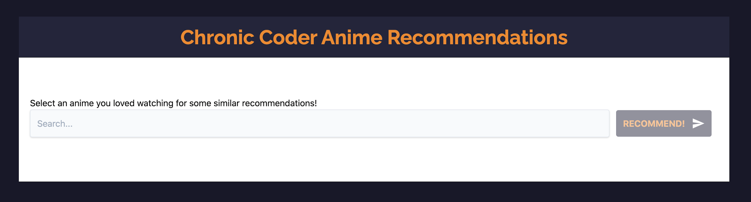
Findings: Usability Test
Landing page
Really simple, minimalistic, but…
“Looks sketchy”
“Is this an anime page”
Users desired visuals on the landing page that immediately tells them it’s an anime page

Slide 24
Findings: Usability Test
Landing page
Tagline/call-to-action clear enough to guide users what to do

Slide 25
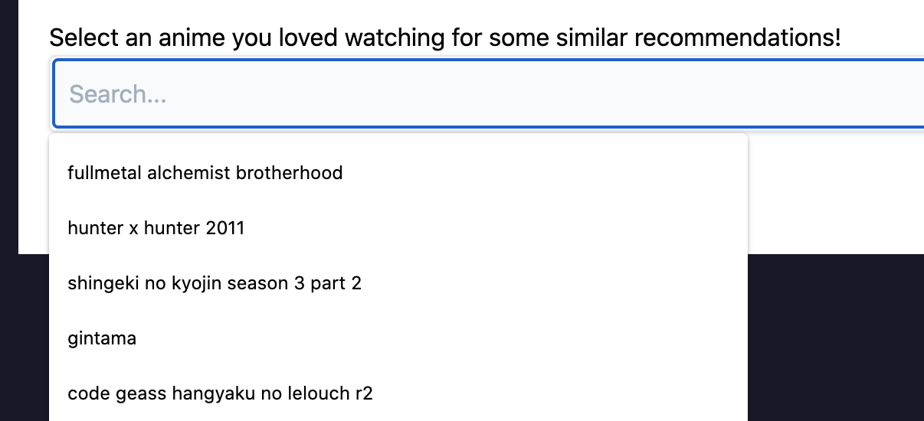
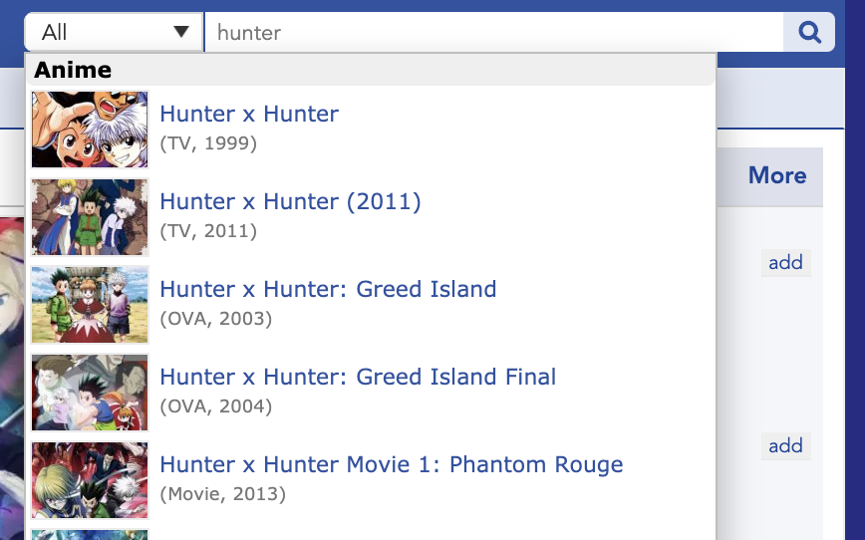
Findings: Usability Test
Search dropdown
Experienced users were used to MyAnimeList’s graphics when searching
There were issues when searching for anime which has multiple names
Some appeared in English, some Japanese

Slide 26
Findings: Usability Test
Recommendations: Overall
User’s opinions on the recommendations are heavily based off posters
If the poster doesn’t look remotely similar to their searched anime, it automatically lowers their confidence
“None of the recommendations look like what I thought would come up.”
Novice user, Jessie (alias)
Users are on the fence about all categories except Newest and Most Similar
All categories had mixed reviews about its recommendations
e.g. Popular and Most Similar has same recommendations across two different searches

Slide 27
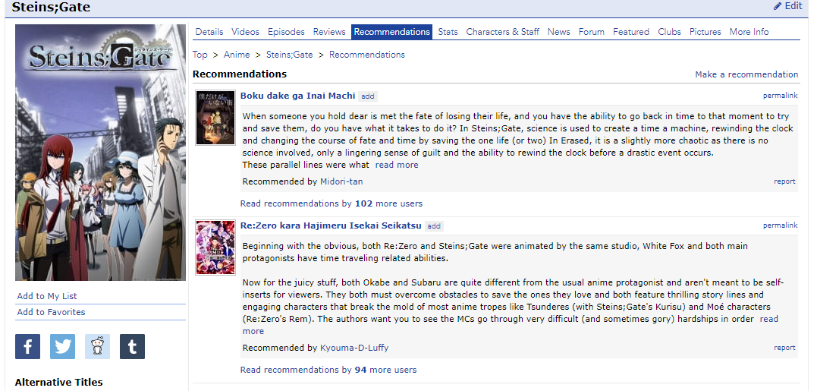
Findings: Usability Test
Recommendations: Overall
Experienced users noted that prototypical anime which are similar to anime they’ve watched were missing
e.g. If you’re searching for Steins;Gate, you’d expect Re:Zero to pop up

Slide 28
Findings: Usability Test
Recommendations: Overall
Similar Plot and Similar Reviews have mixed feelings
Some users think it provides the most unique and usable recommendations
Some of them ignored it as it doesn’t look similar to what they searched
“Similar plot is a hard categorizer (criteria)… I don’t like the idea of it, but it does give the best recommendations.”
Experienced user, Jay (alias)

Slide 29
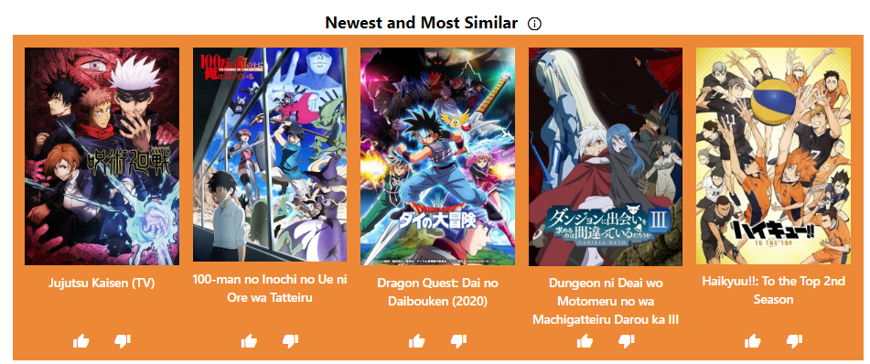
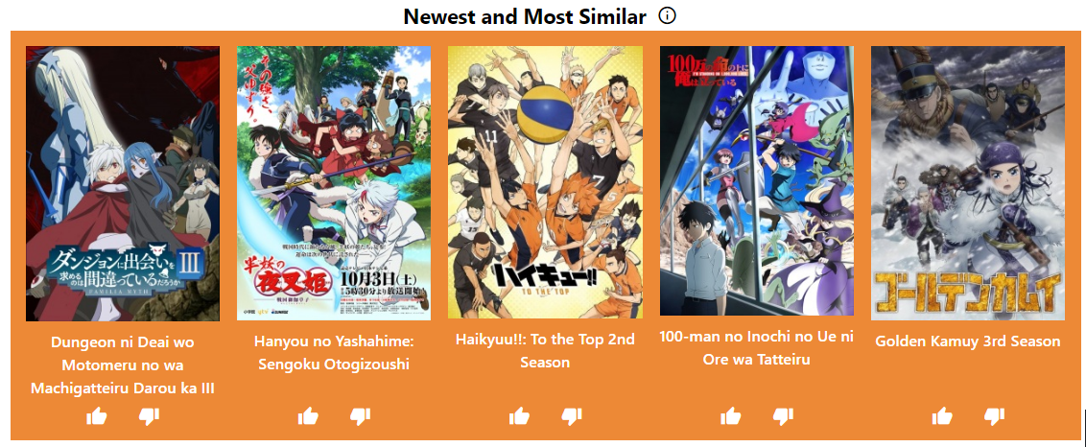
Findings: Usability Test
Recommendations: The Haikyuu Problem
Baki
Cowboy Bebop

Slide 30
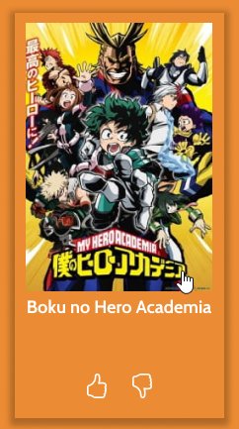
Findings: Usability Test
Recommendations: Pop-up
Required more interaction to indicate clickability (review prototype)
Certain information on the pop-up isn’t important to users
Score
Type
MyAnimeList (debatable)
Users desire more information, specifically:
Streaming links (legitimate)
Genre tags (similar to MAL)
Visuals (keyframes, trailers, etc)
Status of anime (ongoing, done, etc)

Slide 31
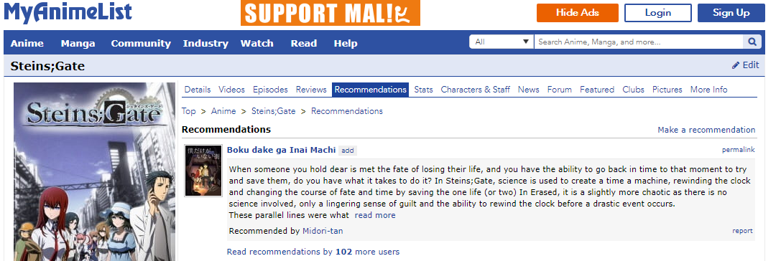
Findings: Usability Test
Recommendations: Pop-up
Users wanted more credibility on the recommendations
Show how an anime is similar to what they searched
e.g. Through a subscore, in terms of genres, etc

Slide 32
Findings: Usability Test
Recommendations: Thumbs up/down
Majority of users (8/10) knew that thumbs up/down helps “vet” recommendations for the site, but…
“Most anime sites have confidence in their algorithm, they typically ask you to rate the anime NOT their algorithm, so this is unexpected.”
Amateur user, Jake (alias)
This feature also assumes that you have prior knowledge of the anime
“I’ll have to watch it (anime) first then return to vote on it. I probably won’t as I’ll forget about it.”
Experienced user, Norman (alias)

Slide 33


Findings: Usability Test
Recommendations: Thumbs up/down
Some users misunderstood the function as a global like/dislike function
It will display how many people liked/disliked the anime
Users expect that downvoted anime will be replaced with a new one
Expected more feedback after up/downvoting the anime (refer to prototype)
vs

Slide 34
Overall Summary
What did we do well?
Colors
“Similar to Crunchyroll”
Lack of onboarding/sign-up
Maybe use cookies to store personal data?
Refer to www.justwatch.com for reference
Concept requires credibility but is good

Slide 35
Overall Summary
What didn’t we do well?
Concept of specific categories and their recommendations
Establishing the credibility of our recommendations
Establishing the reliability of our recommendations
Visual design (yeah…)

Slide 36
Overall Summary
What’s next, boys?
Look at the backend recommendation system again
People prioritize genres, release date, prototypical anime
Suggestion: Weighted recommendation system
More visuals/graphics
Pop-up information design
Visual design
Prototype

Slide 37
Overall Summary
Popular ideas/suggestions
More recommendations
What if one anime in one category is good and they've watched all of them? Do they strike out the entire category?
More categories
Genre-related
More visuals on the homepage
Ability to filter using more categories
Recommendations based on multiple animes

